Slide 1
Entity-Relationship (ER) Model
Week 2 – Part 1

Slide 2
This Week
Week | Lecture Dates (Edgbaston) | Lab Dates (Edgbaston) | Topic
1 | Group 1 - Wednesdays (10:00-12:00) Group 2 - Fridays (12:00-14:00) | Fridays (14:00-17:00) | Introduction to databases; Database design guidelines
2 |  |  | Database design; Entity relation (ER) modelling; Keys; Normalisation​
3
3 |  |  | Creating and populating databases; PostgreSQL
4 |  |  | SQL Querying – Operators, Ordering, Aggregation; NoSQL and Graph Databases
5 |  |  | NoSQL and Graph Databases; Class Test
6 |  |  | Assessment support week
7 |  |  | Web programming introduction; Tech stack, Template application
8 |  |  | Web applications vs Static pages; Tech stack concepts; REST APIs; RESTFUL style
9 |  |  | SpringBoot application structure,; SpringBoot annotations, case study
10 |  |  | Front end concepts, TypeScript fundamentals, Angular front end development,
11 |  |  | Class Test

Slide 3
Learning objectives
What is ER Model?
Why do we need Model?
Various symbols and syntax for ER
ER model examples
Tools we can use for ER diagrams

Slide 4
Introduction to ER Model
An Entity-Relationship (ER) Model is a graphical representation of a database that shows the relationships between different pieces of information.
Think of it as a blueprint for a database. Just like an architect creates a blueprint before building a house, a database designer creates an ER model before building a database.
This model helps us understand the structure of the data, how different parts of the data are connected, and what rules apply to the data.
Notes:
It provides a clear and simple way to visualize the database design, making it easier for everyone involved to understand and discuss.

Slide 5
Why Do We Need Modeling?
Database modeling, especially using ER Models, is crucial before building any database system. Here's why:
Clarity and Communication: It provides a clear visual representation of the database structure, making it easy for developers, clients, and stakeholders to understand and discuss the system.
Better Design: It helps in identifying and correcting design flaws early in the development process, saving time and resources.
Reduced Redundancy: By visualizing relationships, we can minimize data duplication, leading to more efficient and consistent databases.
Data Integrity: It helps in defining rules and constraints to ensure the accuracy and reliability of the data.
Scalability: A well-designed model can easily be expanded or modified as the system grows, ensuring future flexibility.
Notes:
It provides a clear and simple way to visualize the database design, making it easier for everyone involved to understand and discuss.

Slide 6
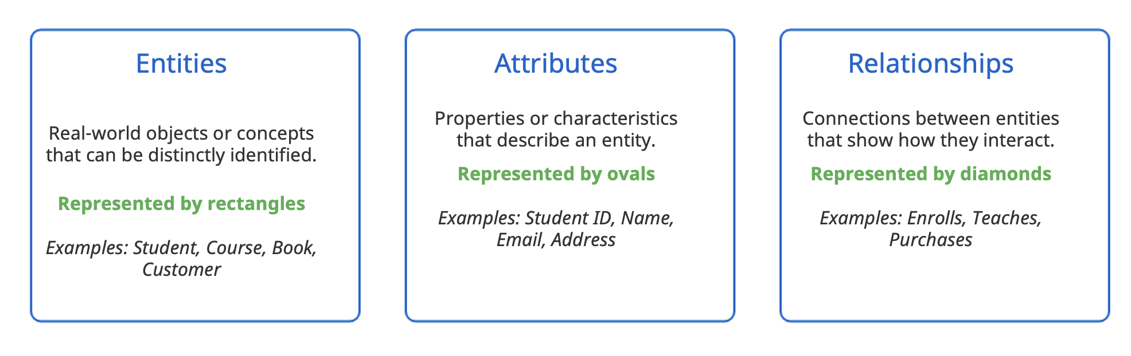
Basic Components of ER Model
The ER model describes data in terms of :
Entities: or mathematical object i.e anything you can (want/need) to define.
Relationship: between two entities
Attributes: properties of the entities (i.e domains of the relation)
A collection od entities sharing the same attributes is called an entity type, analogous to a class in OOP

Slide 7
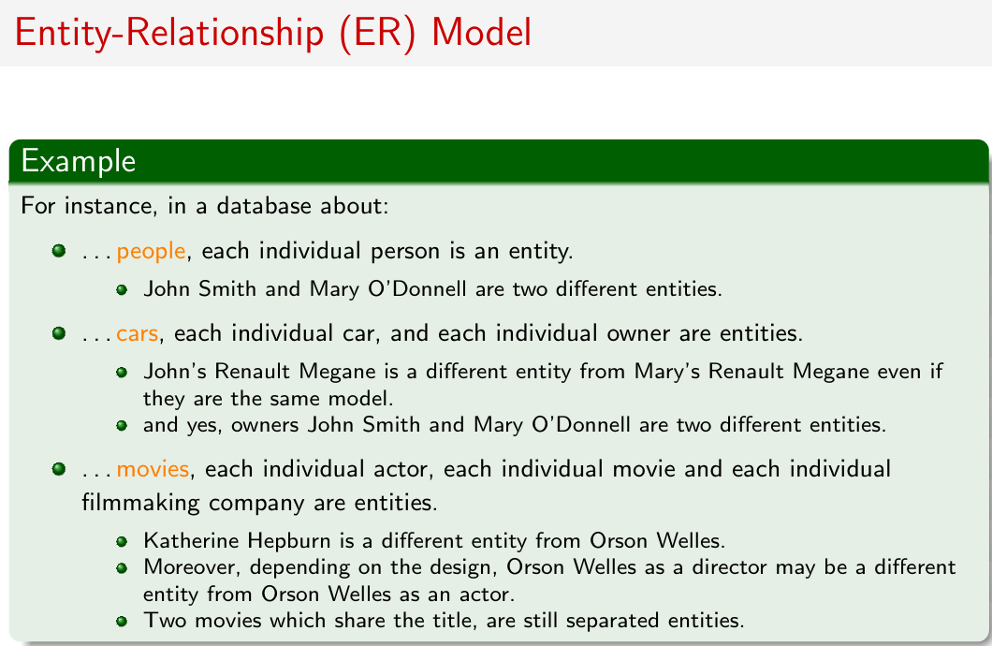

Slide 8
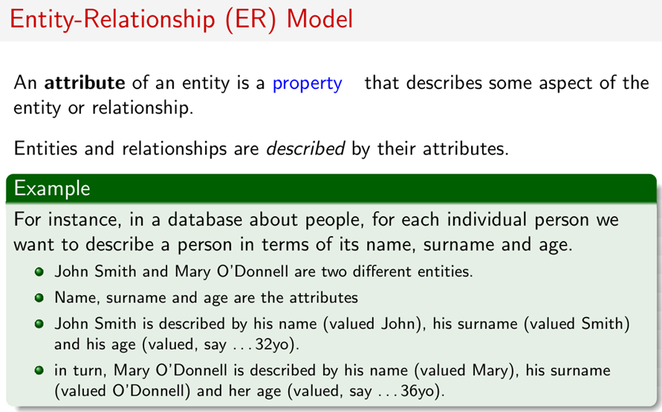

Slide 9
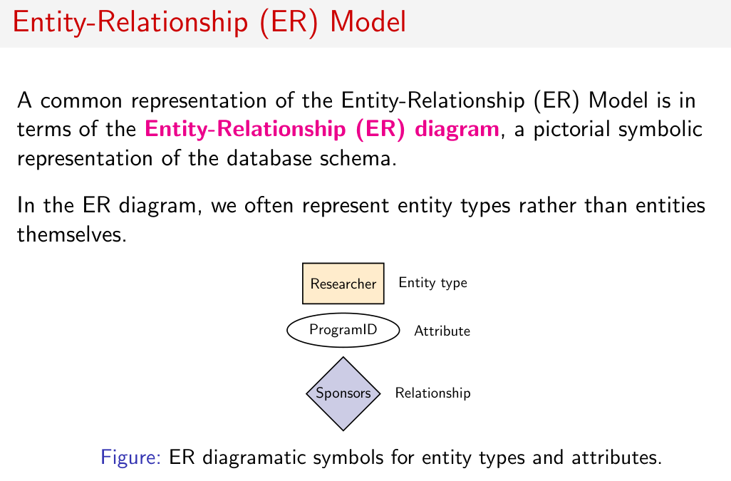

Slide 10
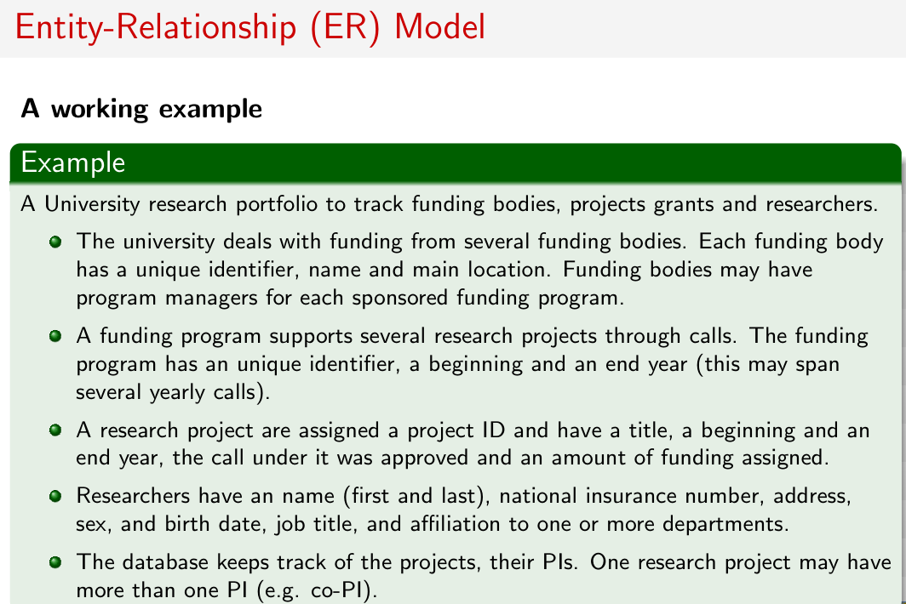

Slide 11
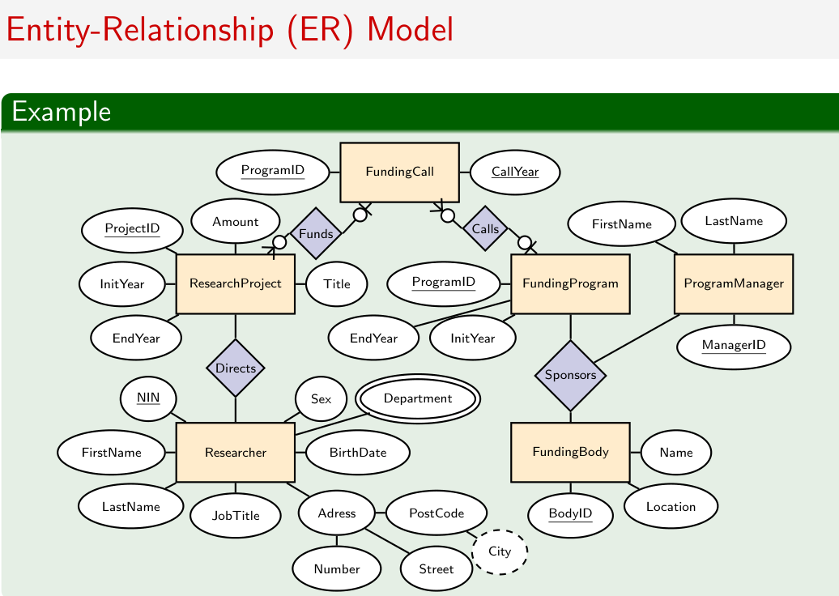

Slide 13
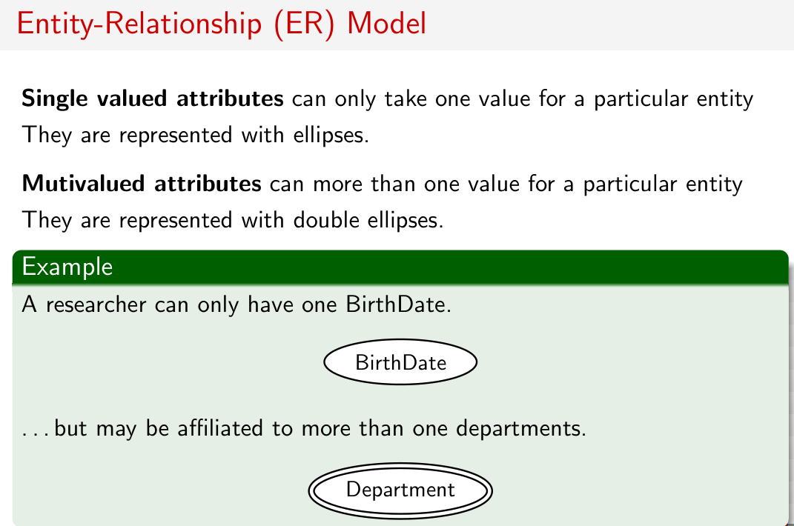

Slide 14
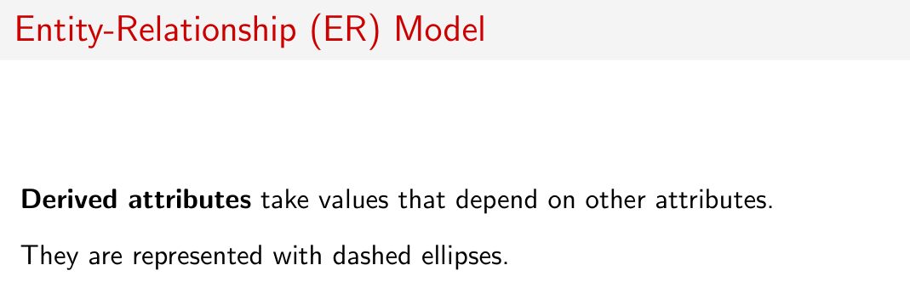
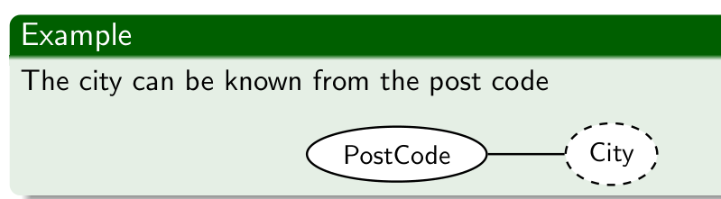

Slide 15
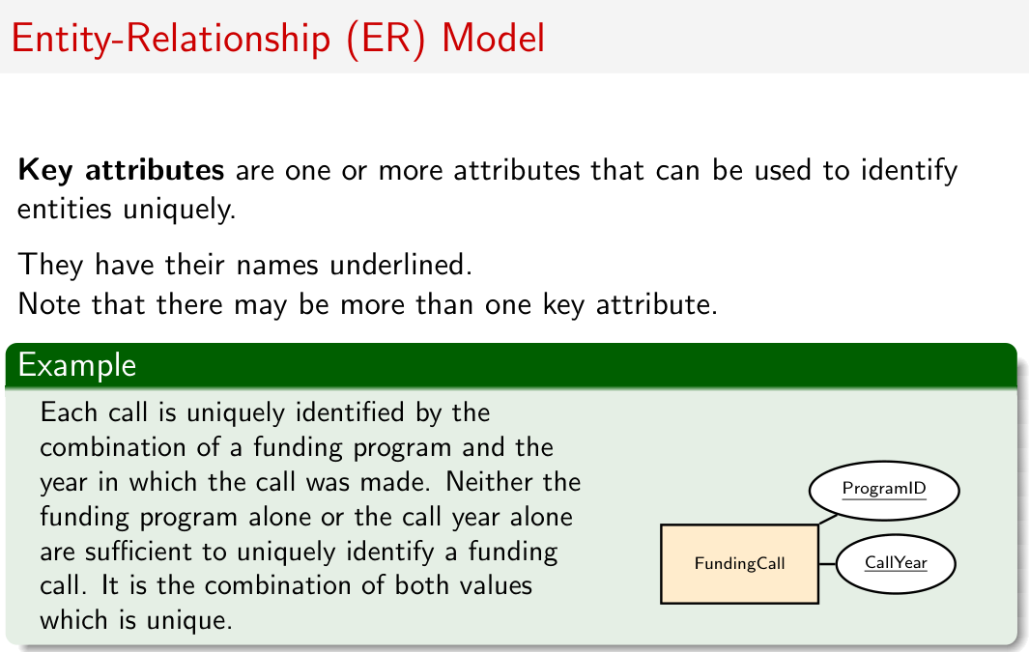

Slide 16
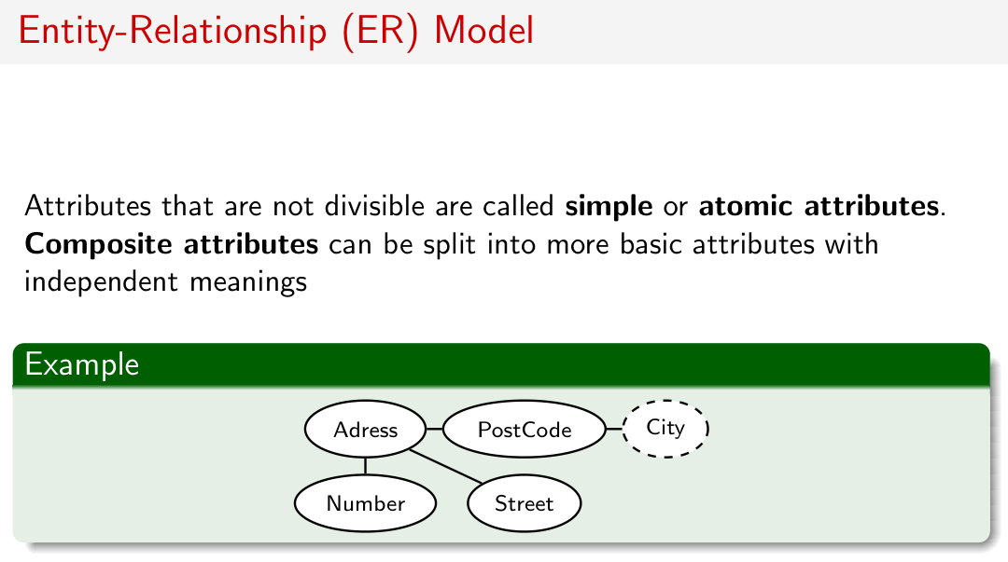

Slide 17
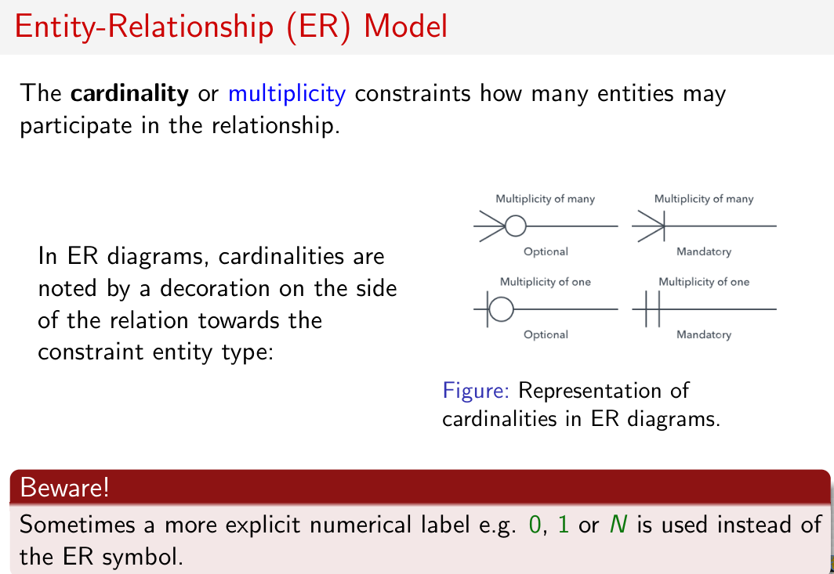

Slide 18
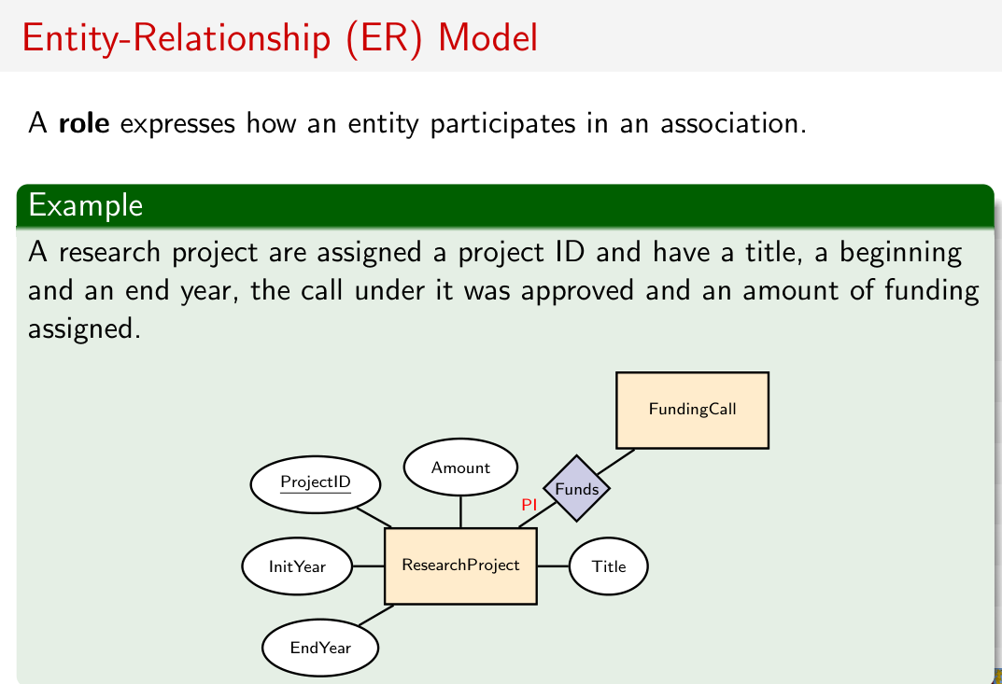

Slide 19
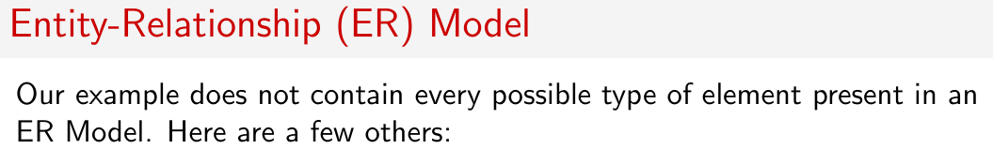
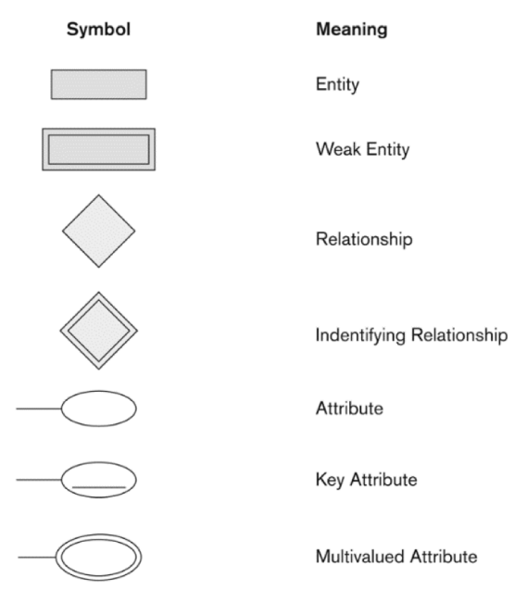
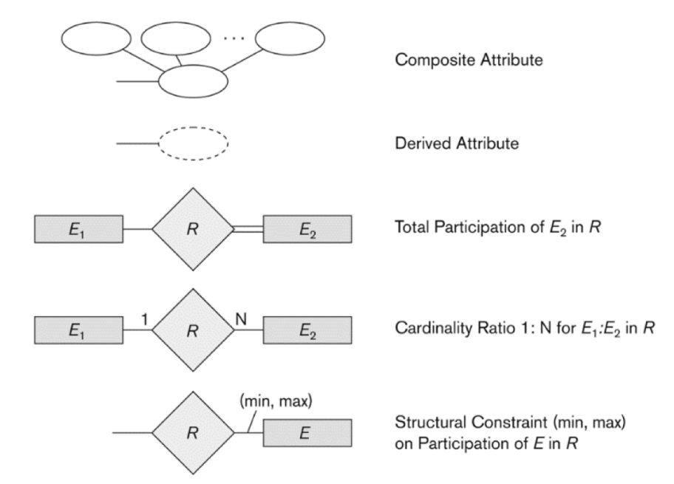

Slide 20
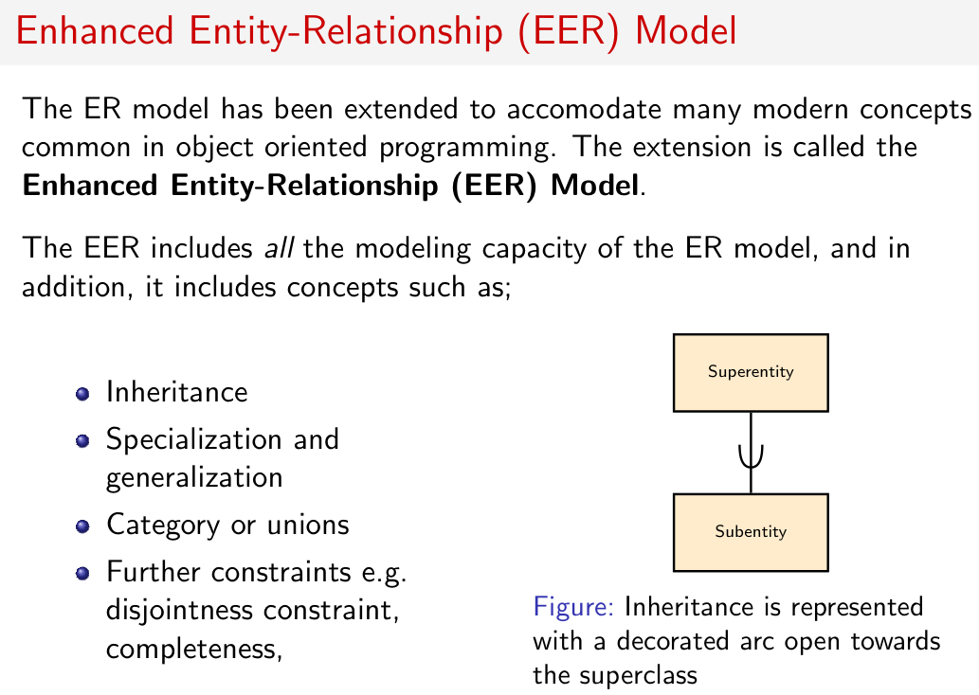

Slide 21
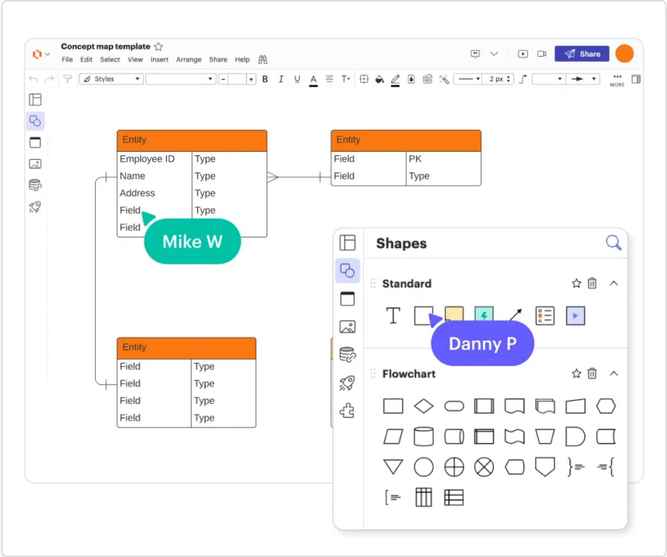
Tools for ER Diagramming
Free/Open Source Tools:
Draw.io: Browser-based, easy to use
MySQL Workbench: For MySQL databases
ERDPlus: Web-based for educational use
Commercial Tools:
Lucidchart: Cloud-based collaboration
Visual Paradigm: Professional design tool
Microsoft Visio: Part of Microsoft Office

Slide 22
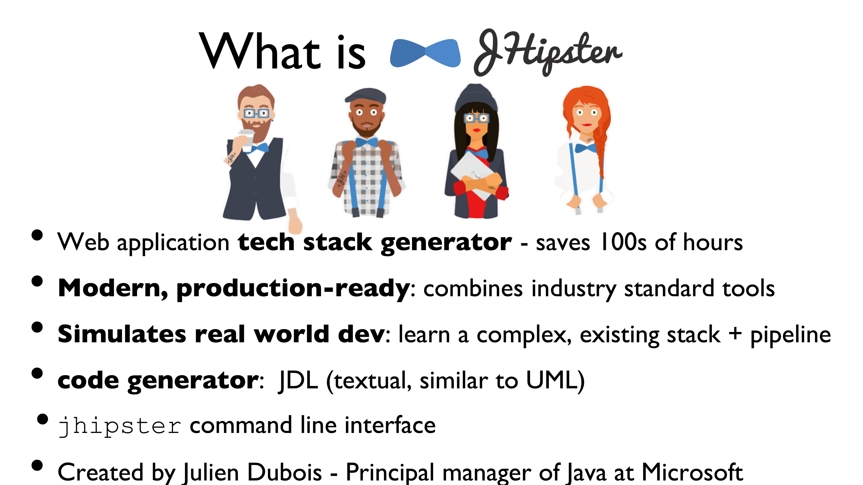
Tools for ER Diagramming JHipster Domain Language - JDL

Slide 23
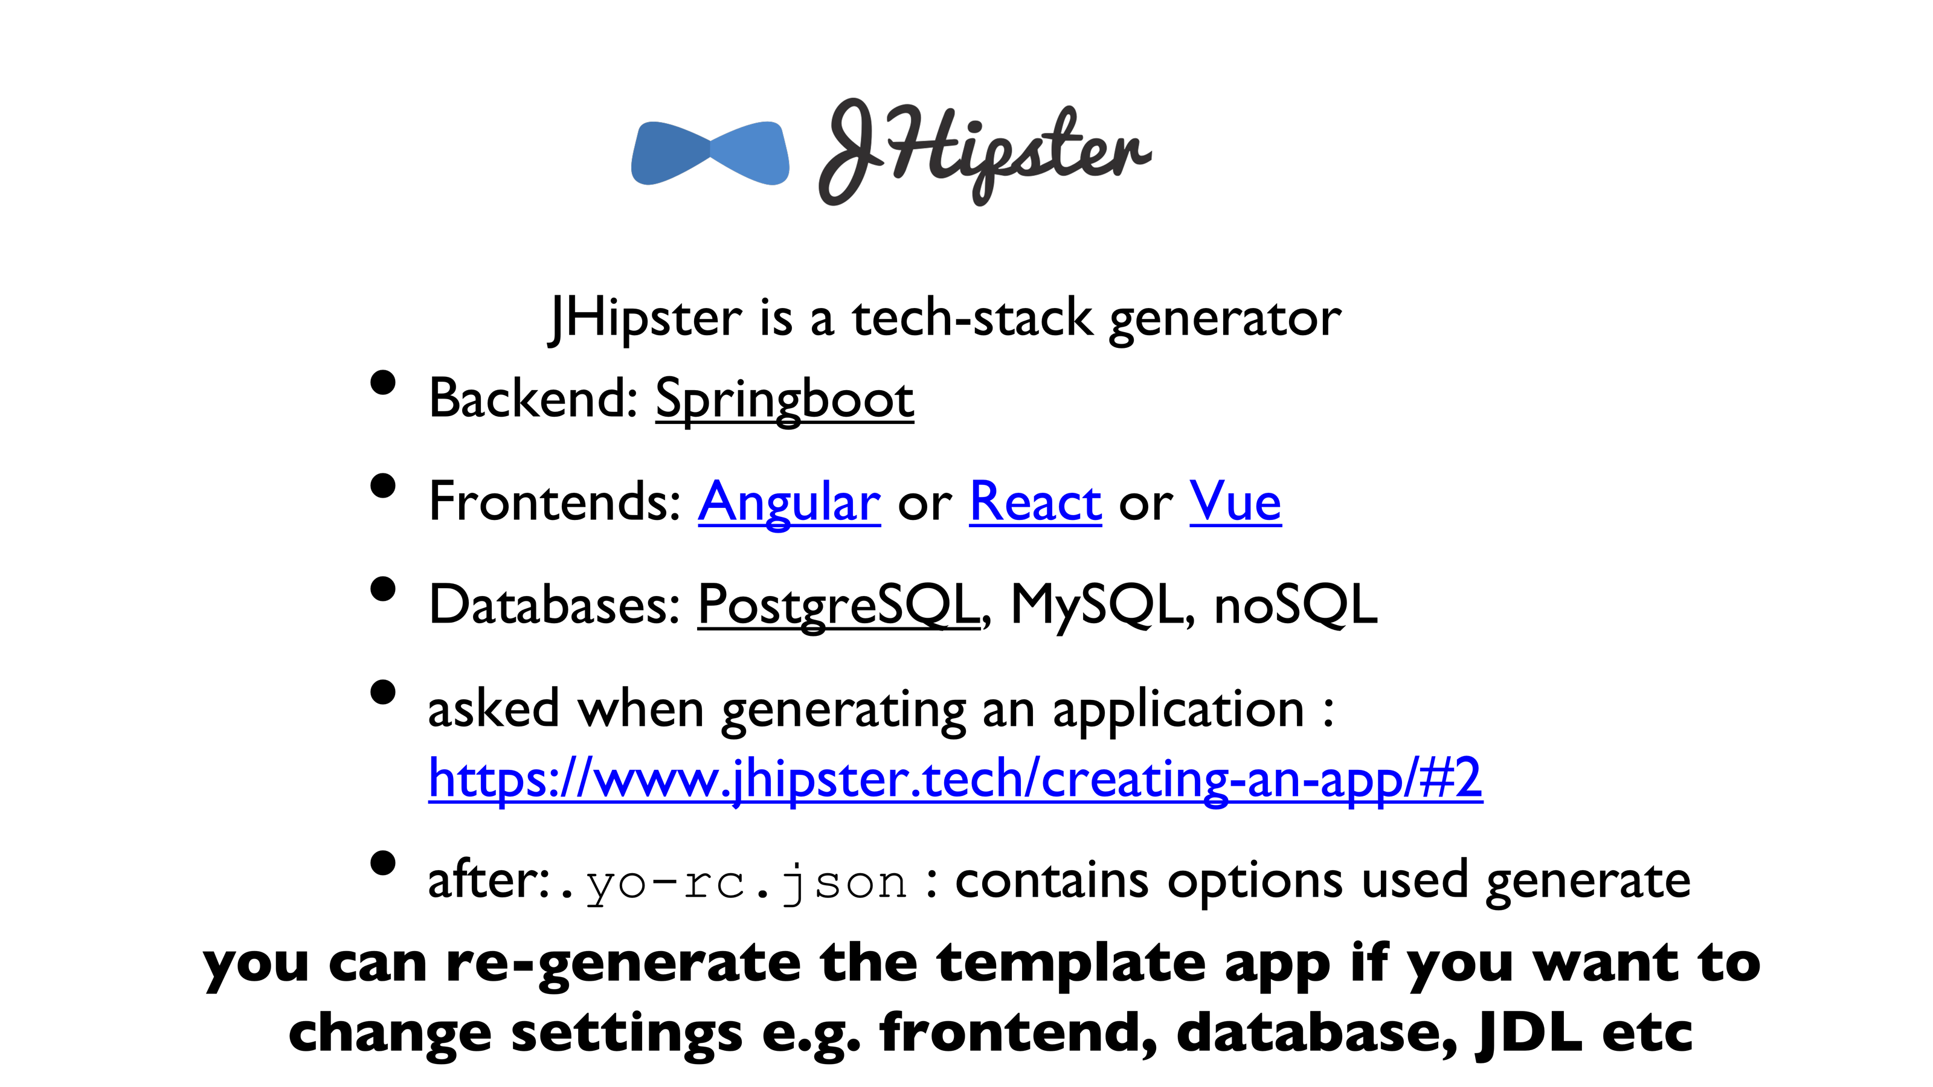

Slide 24
What is JHipster JDL?
JDL = JHipster Domain Language
A DSL (Domain-Specific Language) to describe entities, fields, relationships, and configurations
Used to quickly generate code and ER diagrams
Can be written in .jdl files

Slide 25
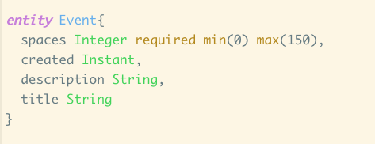
JDL Entity
🤔 think Java or UML or OO class
with attributes
without operations

Slide 26
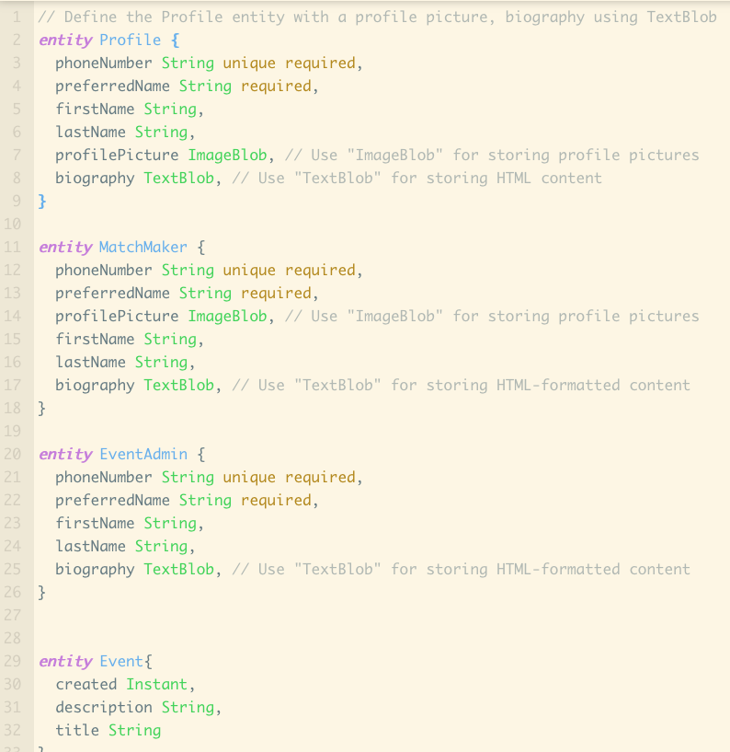
JDL Primitives types
Text
String | Textual data.
TextBlob | Large blocks of text (stored as binary)
Numeric
Integer | Whole numbers.
Long | Large whole numbers.
BigDecimal | Massive, precise decimal numbers.
Float | Floating-point numbers.
Double | Double-precision floats.
Boolean | true or false values.
UUID | Universally Unique Identifier
Dates
LocalDate | A date without a time zone.
Instant | A moment in time in milliseconds.
ZonedDateTime | A date/time with time zone.
Duration | An amount of time.
Other
ImageBlob | An Image stored as binary data
Blob | Generic Binary data
enum | An enumerated type

Slide 27

Primitive Modifiers
After each type declaration can have:
unique values must be unique across all instances of the entity
required value is mandatory and cannot be null/empty
minlength(n) & maxlength(m) length constraints for string
min(x) & max(y) value constraints for numeric attributes example:

Slide 28
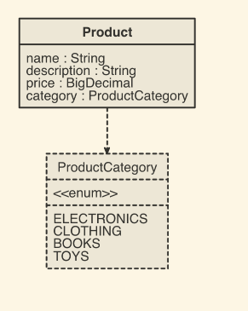
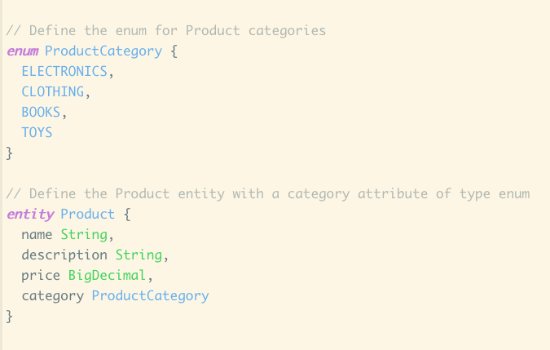
JDL Enum type

Slide 29
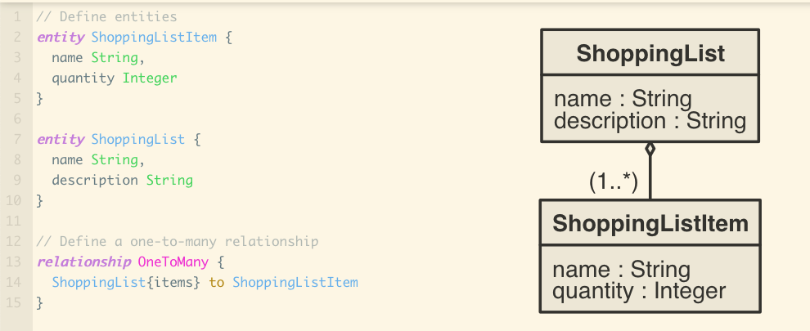
Linking Entities
JDL does not support List / Set directly
So no List<String> or Set<String>types
Use relationship instead (next lectures topic)

Slide 30
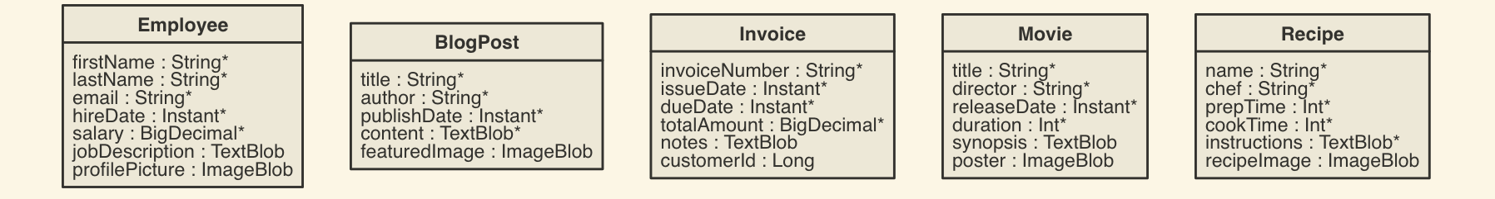
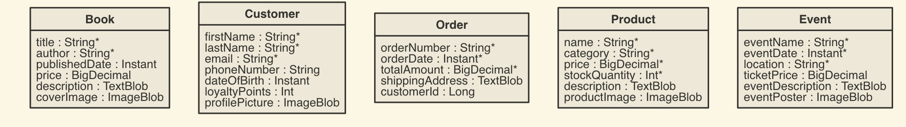
JDL Entity Examples
entity Book {
title String required,
author String required,
publishedDate Instant,
price BigDecimal,
description TextBlob,
coverImage ImageBlob
}
entity Customer {
firstName String required,
lastName String required,
email String required,
phoneNumber String,
dateOfBirth Instant,
loyaltyPoints Integer,
profilePicture ImageBlob
}
entity Order {
orderNumber String required,
orderDate Instant required,
totalAmount BigDecimal required,
shippingAddress TextBlob,
customerId Long
}
entity Product {
name String required,
category String required,
price BigDecimal required,
stockQuantity Integer required,
description TextBlob,
productImage ImageBlob
}
entity Event {
eventName String required,
eventDate Instant required,
location String required,
ticketPrice BigDecimal,
eventDescription TextBlob,
eventPoster ImageBlob
}

Slide 31
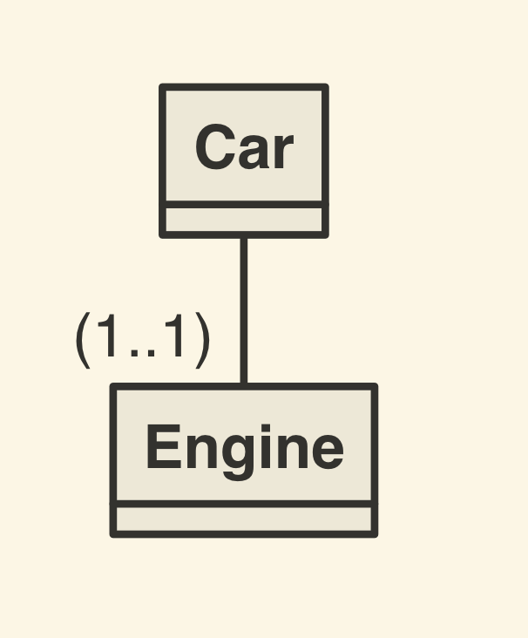
Multivalued types
JDL does not support List so no List<String> or Set<ImageBlob>types
Use relationship instead
entity Car
entity Engine
relationship OneToOne {
Car to Engine
}
Database: Car table has a foreign key column for engine
Form Label: How is this relationship labeled in the +Create Car and View Car web form?
Instance identity: How do we pick exactly which Engine a Car has?
Navigability/Bidirectionally/Ownership: Does the Engine ‘know’ which Car it belongs to?

Slide 32
JDL Relationship Types
OneToOne: each instance of one entity is associated with exactly one instance of another entity
OneToMany: each instance of one entity can be associated with multiple instances of another entity, instances of the second entity are associated with only one instance of the first entity
ManyToOne: opposite of OneToMany
ManyToMany: relationship indicates that multiple instances of one entity can be associated with multiple instances of another entity
https://www.jhipster.tech/jdl/relationships

Slide 33
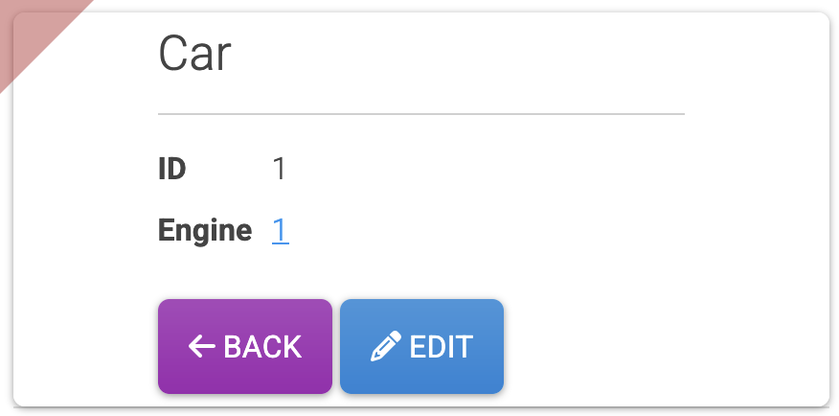
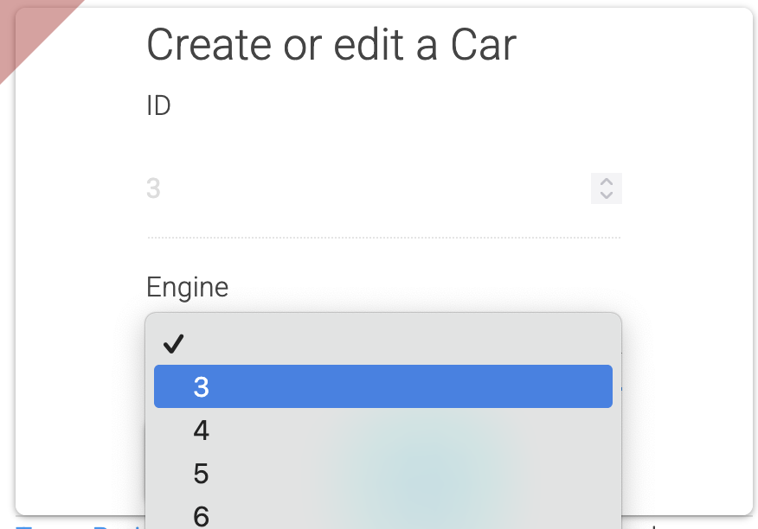
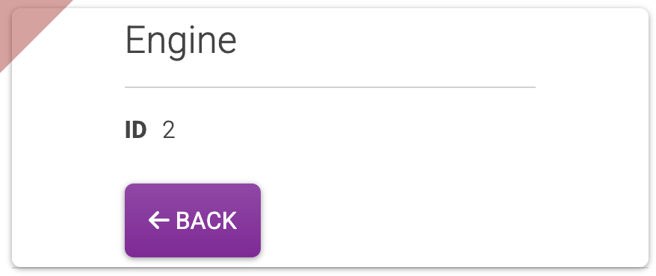
OneToOne
entity Car
entity Engine
relationship OneToOne {
Car to Engine
}
Form Label - defaults to Entity name i.e. Engine - customisable label
Instance identity: defaults to Database ID of target - we can customise which field
Navigability : by default the Engine won’t ‘know’ which Car it belongs to
Constraint: only one target entity can belong to a source entity at a time
When should we use OneToOne relationships?

Slide 34
When should we use OneToOne relationships?
When two entities are basically one item but we separate out for modularity
Examples:
Car - Engine
User - UserProfile
House - FrontDoor
When the target has lot of fields that would pollute the source entity
e.g. in the car example if engine contains many “parts” fields

Slide 35
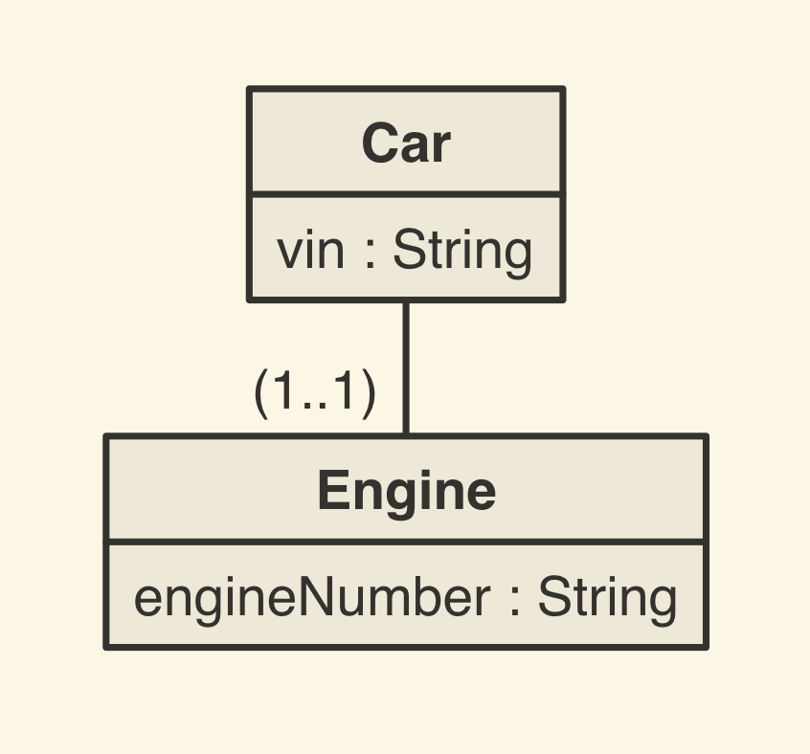
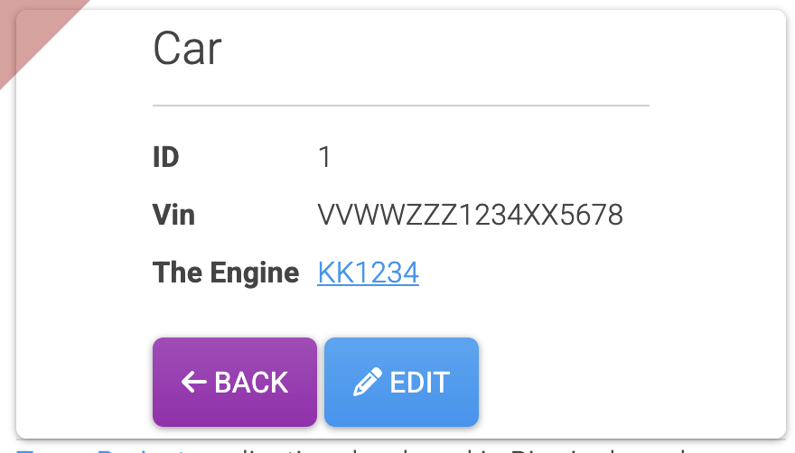
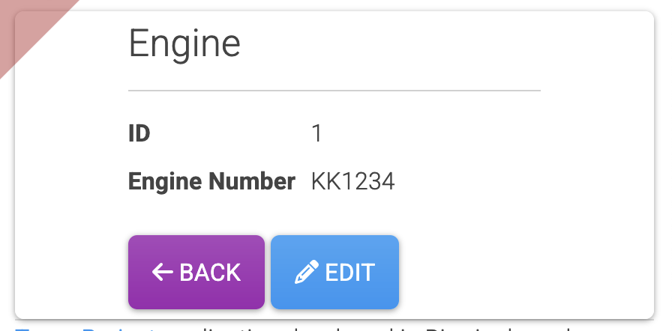
Customise Relations
entity Car{
vin String
}
entity Engine{
engineNumber String
}
relationship OneToOne {
Car{theEngine(engineNumber)} to Engine
}
Form Label:
customised to “The Engine”
Instance identity:
customised to “Engine Number” from Engine
n.b. no spaces in JDL - use camelCase labels to get Title Case
Issue: How can an Engine ‘know’ which Car it belongs to?

Slide 36
Bidirectional Relations
entity Car{
vin String
}
entity Engine{
engineNumber String
}
relationship OneToOne {
Car{theEngine(engineNumber)} to Engine{theCar(vin)}
}
Bidirectional Relationship:
Specific a label (+instance field) for the target
n.b. this does not change the database - only the relationship owner (car) has the foreign key field

Slide 37
OneToMany

Slide 38
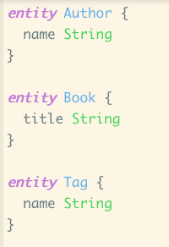
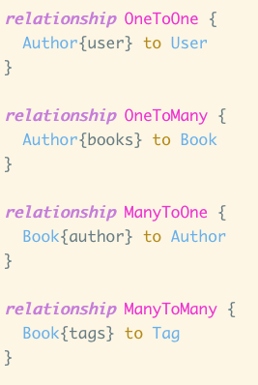
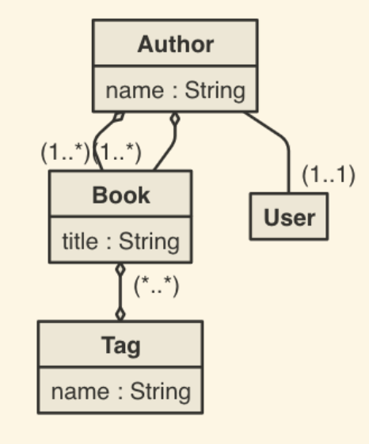
JDL example relationships
N.b. User is a built in class - links your app to JHipster users/login

Slide 39




JDL relationships: example instances
Fantasy:Tag
SK:User
StephenKing:Author
PS:User
TheTalisman:Book
Dark:Tag
PeterStraub:Author
HL:User
HarperLee:Author
TKAMB:Book
Fiction:Tag
GSAW:Book
SouthernGothic:Tag
N.b. JHipster does not fully maintain bi-directional relationships

Slide 40

Getting started with JDL Studio
https://www.jhipster.tech/jdl-studio/

Slide 41
Classroom Activity
Task:
Go to JDL Studio.
Define an ER model for a Library System with:
Entity Book (title, author, publishedYear)
Entity Member (name, email)
Entity Loan (loanDate, returnDate)
Relationships:
Member → Loan (One-to-Many)
Book → Loan (One-to-Many)
Export your ER diagram.

Slide 42
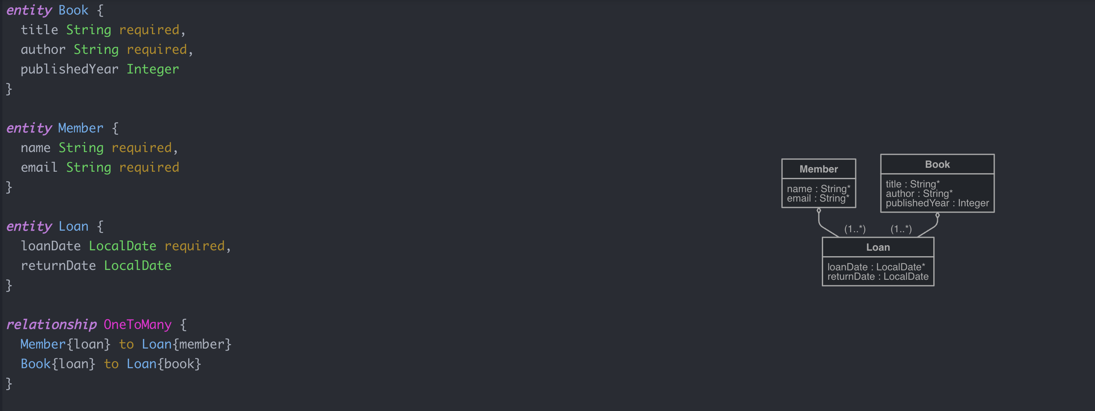
Classroom Activity: Solution
entity Book {
title String required,
author String required,
publishedYear Integer
}
entity Member {
name String required,
email String required
}
entity Loan {
loanDate LocalDate required,
returnDate LocalDate
}
relationship OneToMany {
Member{loan} to Loan{member}
Book{loan} to Loan{book}
}

Slide 43
Example
entity Student {
name String required,
email String required
}
CREATE TABLE student (
id BIGINT AUTO_INCREMENT PRIMARY KEY,
name VARCHAR(255) NOT NULL,
email VARCHAR(255) NOT NULL
);

Slide 44
Example
entity Author {
name String required
}
entity Book {
title String required,
publishedYear Integer
}
relationship ManyToOne {
Book{author(name)} to Author
}
CREATE TABLE author (
id BIGINT AUTO_INCREMENT PRIMARY KEY,
name VARCHAR(255) NOT NULL
);
CREATE TABLE book (
id BIGINT AUTO_INCREMENT PRIMARY KEY,
title VARCHAR(255) NOT NULL,
published_year INTEGER,
author_id BIGINT,
CONSTRAINT fk_author FOREIGN KEY (author_id) REFERENCES author(id)
);

Slide 45
Activity: Create your first ER Diagram Groups of 2-3 students
Scenario: Online Bookstore: You are designing a database for an online bookstore. The system needs to track:
Books with details like ISBN, title, price, and publication date
Authors with name, biography, and contact information
Customers who register with name, email, and shipping address
Orders placed by customers, including date and status
Book categories like fiction, non-fiction, science, etc.
Consider these relationships:
Books are written by one or more authors
Books belong to one or more categories
Customers place orders
Orders contain one or more books
Read the scenario on the right and identify the main entities, attributes, and relationships
Draw your ER diagram on paper using the symbols we've learned
Determine the cardinality of each relationship
Share your diagram with another group and discuss differences

Slide 46
Questions

Slide 47
Summary
What is ER?
Why do we need ER model?

Slide 48
References
Ramakrishnan, R., Gehrke, J. and Gehrke, J., 2003. Database management systems (Vol. 3). New York: McGraw-Hill.Rochester
University of Cambridge, Lecture 7: Schema Refinement and Normalisation
Examples on database anomalies from Rochester Institute of Technology, 03- Database Normalisation, Available online

